Slide 1
Data-Driven Real-Time State Estimator Using Machine Learning for Transmission System
Tasks 5, 6, and 7
Evangelos Farantatos, Paul Myrda, Mahendra Patel
EPRI
Anamitra Pal, Assistant Professor
Arizona State University
Apr 08, 2022

Slide 2

Presentation Outline
Project Objectives
Project Timeline
Problem Overview
First Year Summary
Task 5 Updates
Task 6 Updates
Task 7 Updates
Summary and Upcoming Tasks

Slide 3
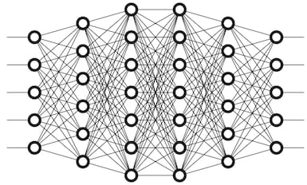
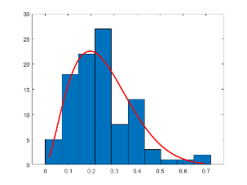
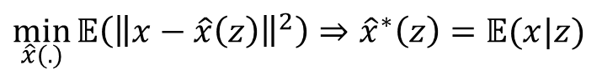
Data Driven Real Time State Estimator using Machine Learning for Transmission Systems
OBJECTIVES:
Develop a Bayesian state estimator with the following characteristics:
Capable of estimating states (complex voltages) in the presence of measurements from topologically unobserved systems
Independent of the measurement error distribution
Capable of estimating states at the rate of 30 samples per second utilizing time-synchronized measurements as real-time inputs
Develop approaches to counter bad data and test their robustness against different types of bad/missing data
Develop ways to update the Machine Learning (ML)-based state estimator in presence of topology changes and system events
Offline Learning
Online Implementation
Probability distribution fitting from input data
Real-time PMU measurements
State Estimates
Optimized DNN parameters
Monte Carlo sampling
Training sample generation
Deep neural network (DNN) training
Approximating conditional expectation
$\min_{\hat{x}(.)}{𝔼\left({\left\|x−\hat{x}\left(z\right)\right\|}^{2}\right)⇒{\hat{x}}^{∗}\left(z\right)=}$ $𝔼(x|z)$

Slide 4
Data Driven Real Time State Estimator using Machine Learning for Transmission Systems
Timeline
Task | Topic | Due Date | Oct.-Feb. | Mar.-Jul. | Aug.-Nov.
1 | Machine Learning Model Development for State Estimation | Feb. 28, 2021
2 | Machine Learning Based State Estimation with Limited Number of PMUs | Jul. 30, 2021
3 | Machine Learning Based State Estimation with Missing and Bad Data | Nov. 30, 2021
4 | Machine Learning Based State Estimation under Event Conditions and System Topology Changes | Nov. 30, 2021

Slide 5
Data Driven Real Time State Estimator using Machine Learning for Transmission Systems
Timeline Contd.
Task | Topic | Due Date | Dec.-Apr. | May-Sep. | Oct.-Dec.
5 | Machine Learning Based State Estimation Output Post-Processing | April 30, 2022
6 | Machine Learning Based State Estimation Software Development | Sep. 30, 2022
7 | Machine Learning Based State Estimation Case Studies | Dec. 31, 2022
-- | Final Report and Software Tool | Dec. 31, 2022

Slide 6
First Year Summary

Slide 7
Outcomes of the First Year
Optimal tuning of the hyperparameters of a deep neural network (DNN) carried out using a random search framework
Even with smaller number of PMUs [13 instead of 32], the DNN state estimation (SE) model was able to reasonably estimate the states of the IEEE 118-bus system
The state estimation results were good even in presence of non-Gaussian noise in the measurements as well as topology changes
By employing the Wald Test in combination with an extreme scenario filter, the proposed approach was made robust against bad/missing data

Slide 8
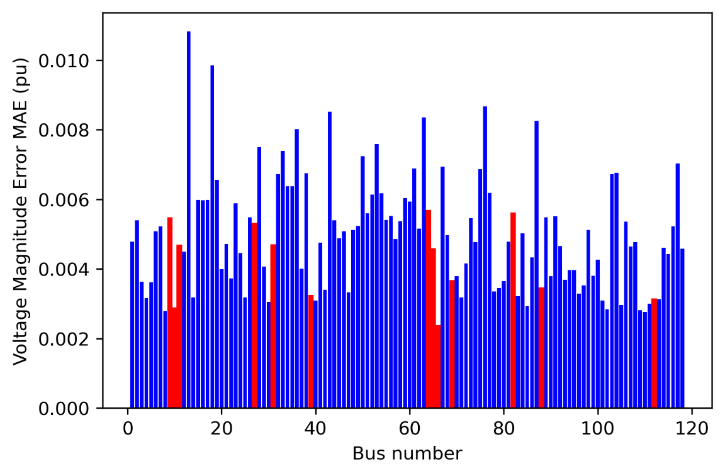
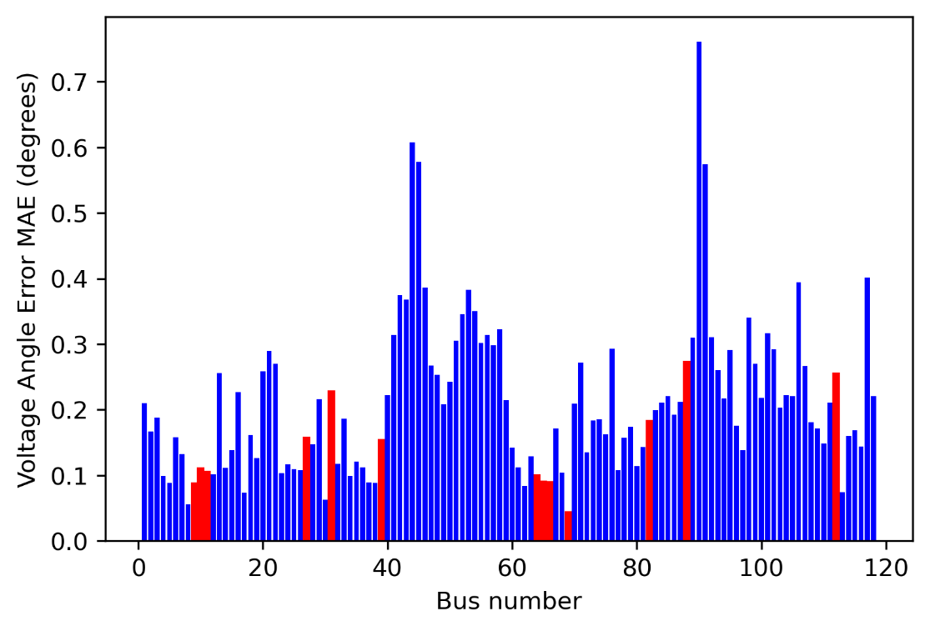
DNN-SE Results with 13 PMUs in presence of Laplacian noise
Red color: Bus locations where PMUs are placed
Blue color: Bus locations where PMUs are not placed

Slide 9
Task 5 Updates

Slide 10
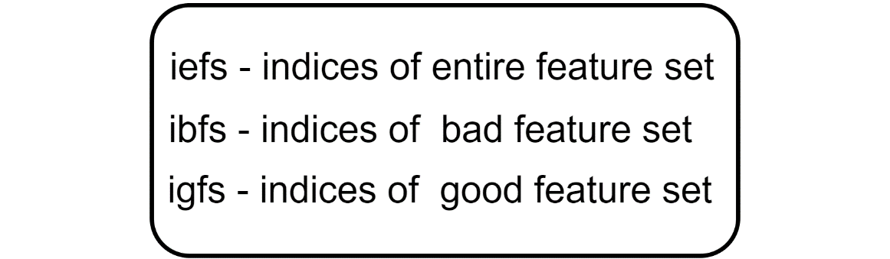
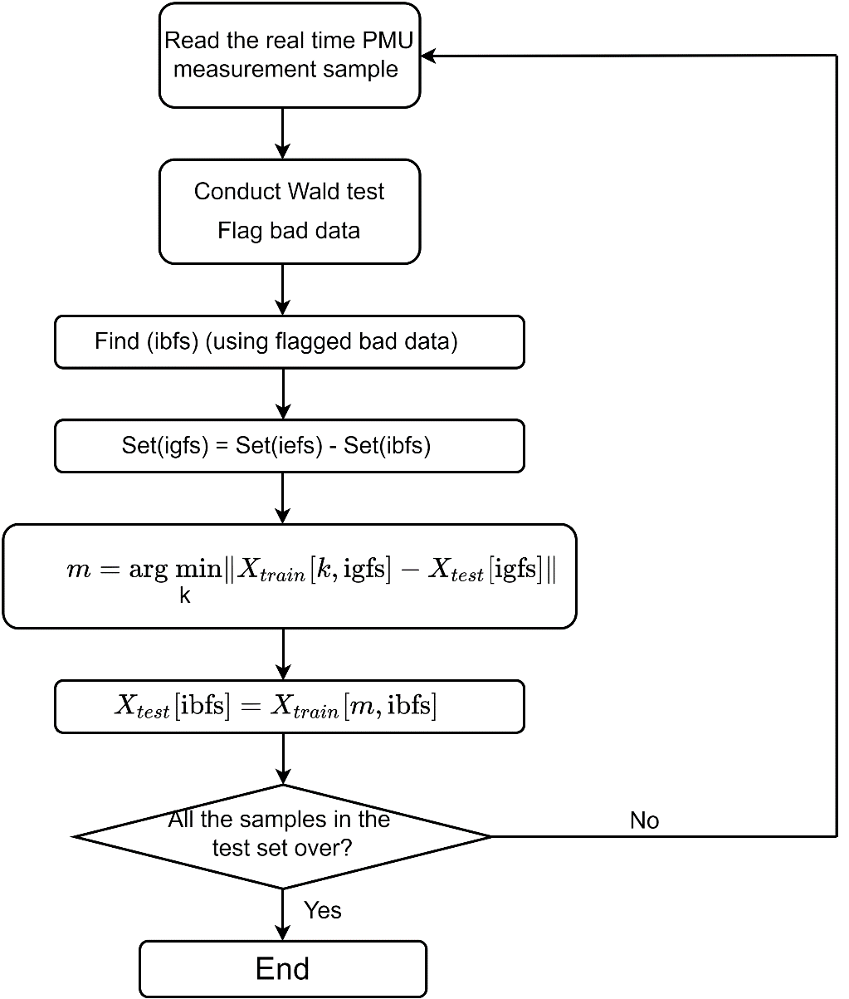
Bad Data Replacement with Nearest Operating Condition
igfs
ibfs
0 | 1 | 2 | 3 | 4 | 5 | 6
1.04 | 1.02 | 1.23 | 1.06 | 1.01 | 1.25 | 1.05
Find the nearest operating condition (OC) using Set(igfs)
Replace bad data with the nearest OC of the training database in the least squares-sense

Slide 11
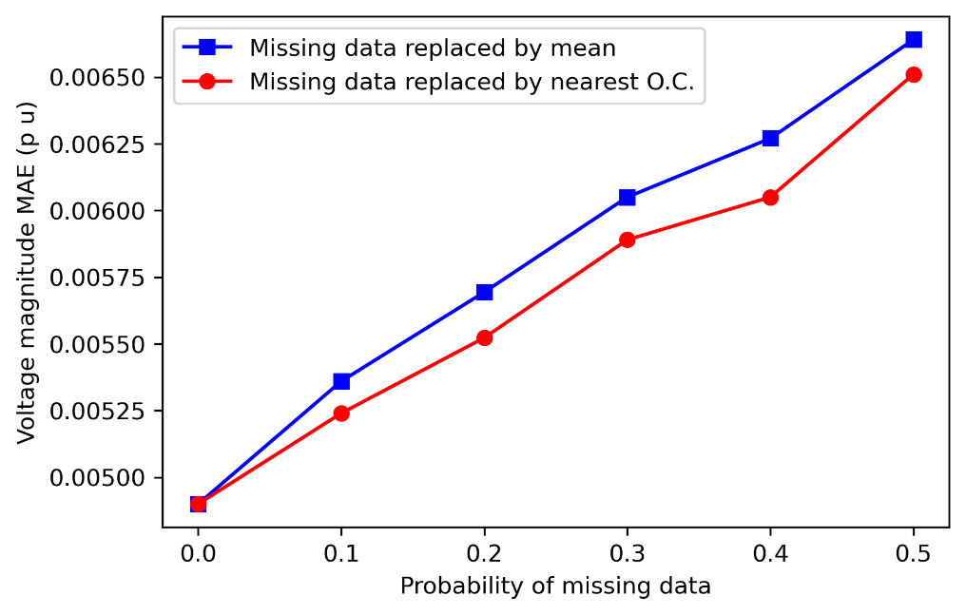
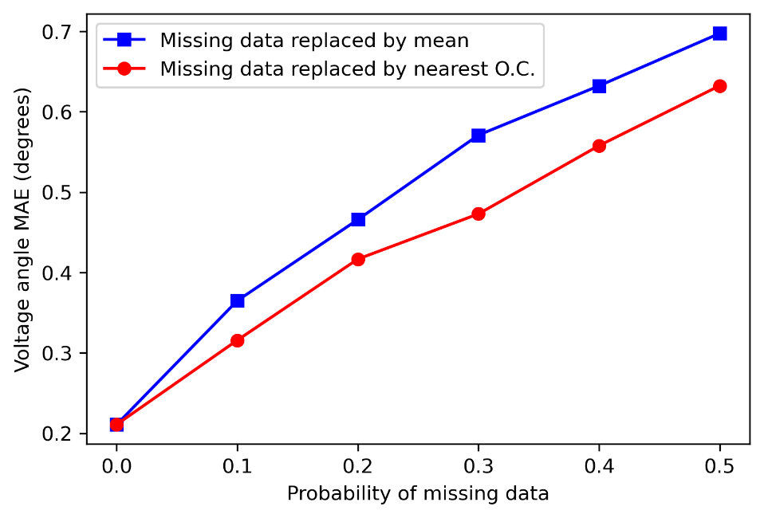
Impact of Bad Data on SE Accuracy
Replacing bad data using the nearest OC results in higher accuracy when compared to replacing using the mean value
This novel bad data replacement scheme has a computational complexity of O(n), where n denotes the number of samples in the training data set and O denotes the big O notation

Slide 12
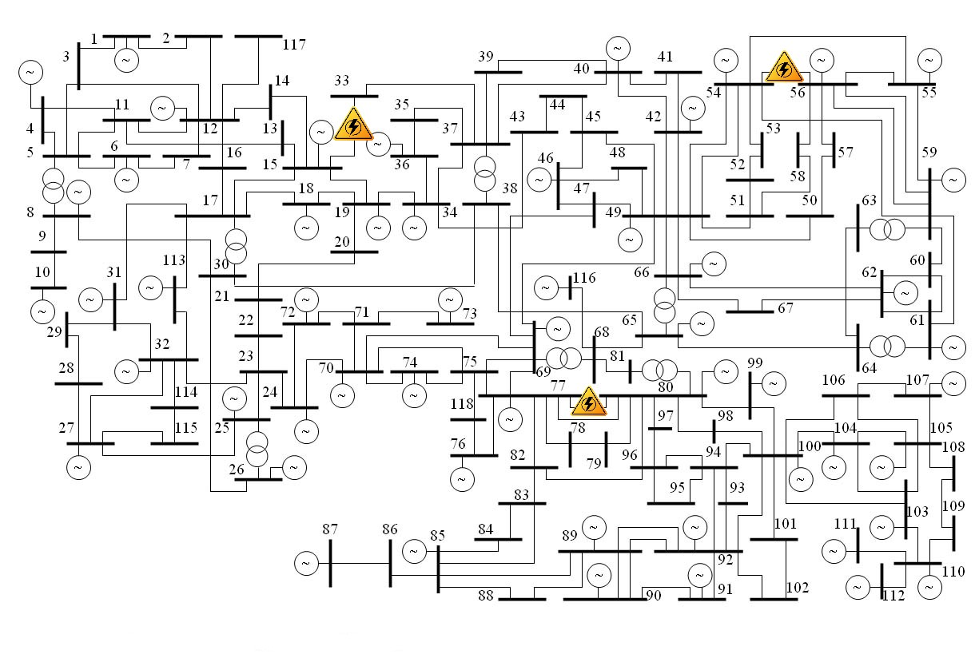
DNN-based Event (Line Outage) Detection
Topologies considered:
Base topology
Line B₁₅- B₃₃ outage
Line B₇₇- B₈₀ outage
Line B₅₄- B₅₆ outage

Slide 13
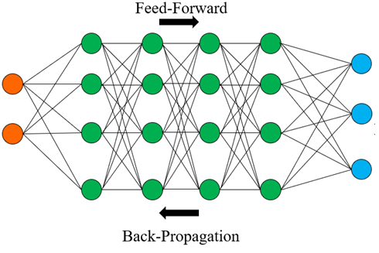
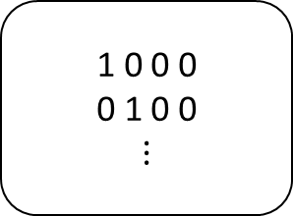
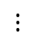
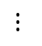
DNN-based Event (Line Outage) Detection
T1
T2
T3
T4
Data pre-processing (shuffling, normalization)
1 0 0 0
0 1 0 0
$$⋮$$
$$⋮$$
$$⋮$$
One-hot encoded labels
Voltage, Current PMU measurements - corresponding to each topology
Accuracy of classification: 87.1% (Range: [86.5%, 87.7%])

Slide 14
Task 6 Updates

Slide 15
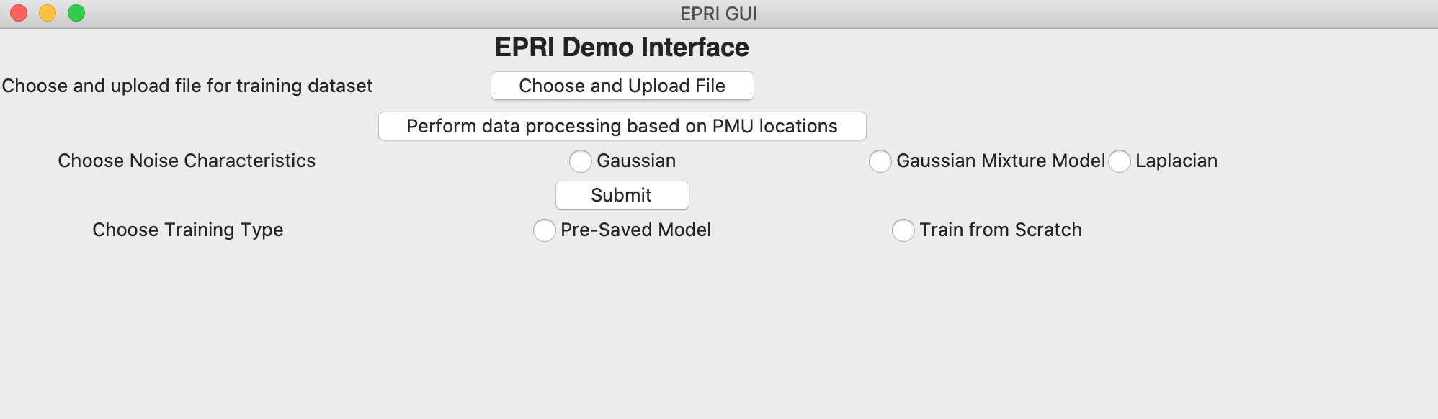
Main GUI
Allows users to choose files of interest

Slide 16
Main GUI
Performs data processing based on defined PMU locations in the grid

Slide 17
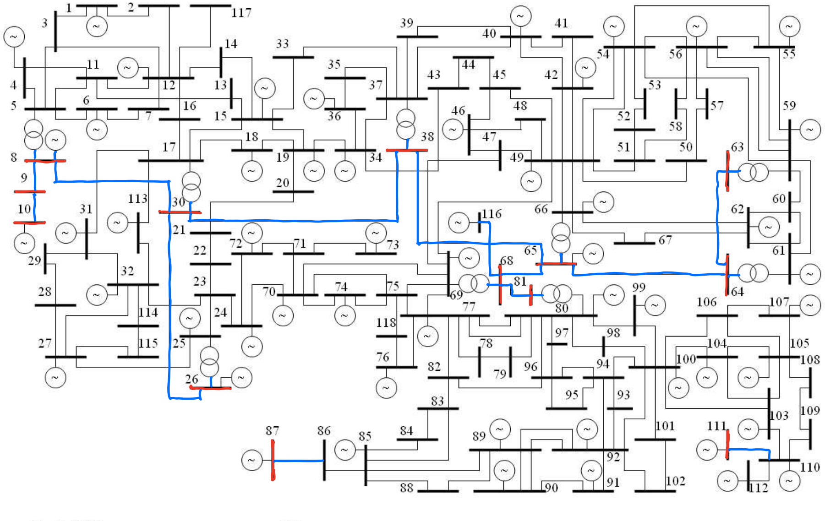
Data Pre-processing
Red – Buses with PMU
Blue – Lines observed by PMUs

Slide 18
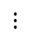
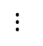
Creating the Input and Output Data-sets
Vm_{PMU} | Va_{PMU} | Im_{PMU} | Ia_{PMU}
Vm | Va
$$⋮$$
$$⋮$$
Input
Output
Vm_{PMU} - Voltage magnitude PMU measurements
Va_{PMU} - Voltage angle PMU measurements
Im_{PMU} - Current magnitude PMU measurements
Ia_{PMU} - Current angle PMU measurements
Vm – Voltage magnitudes of all the buses
Va – Voltage angles of all the buses

Slide 19
Main GUI
3 noise options; currently showing Gaussian noise option

Slide 20
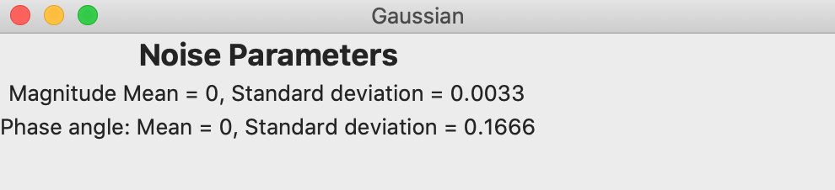
Noise Prompt

Slide 21
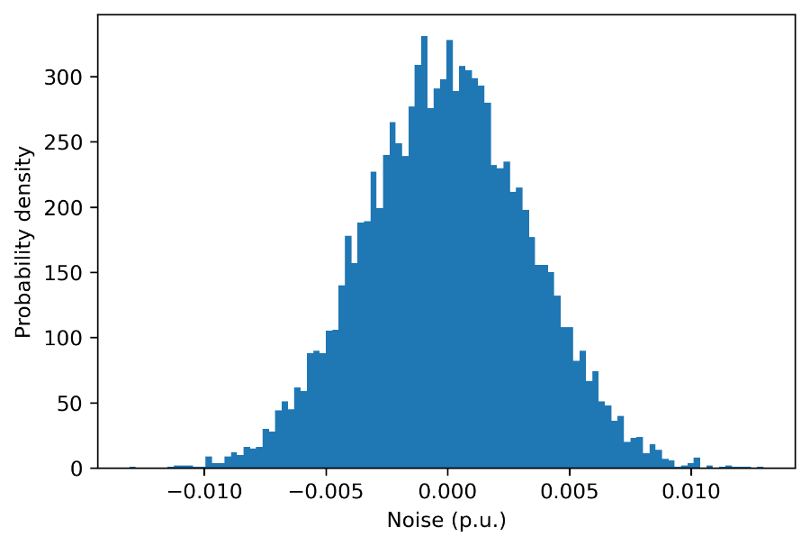
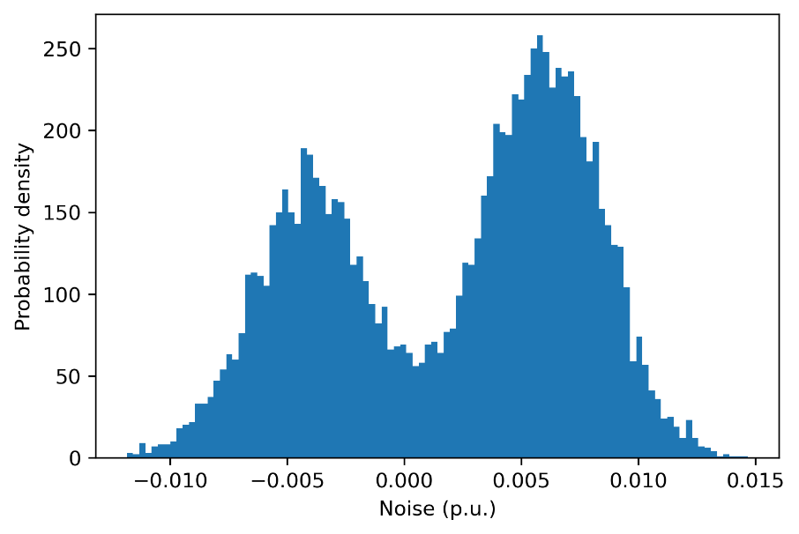
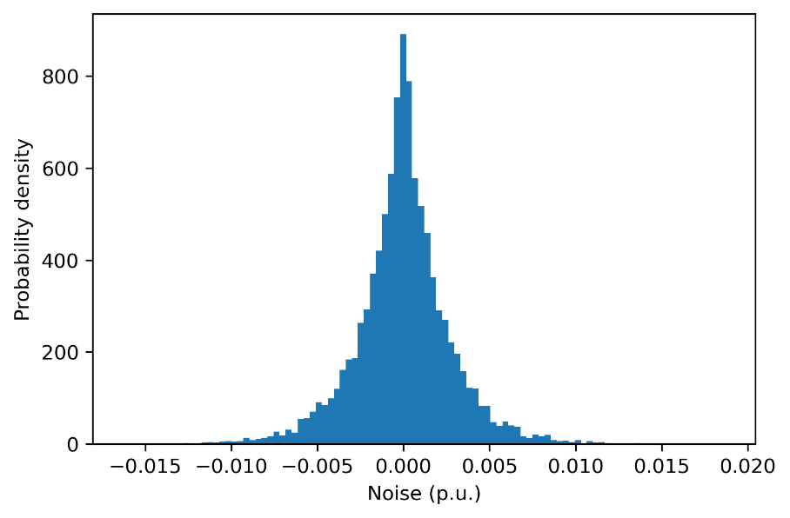

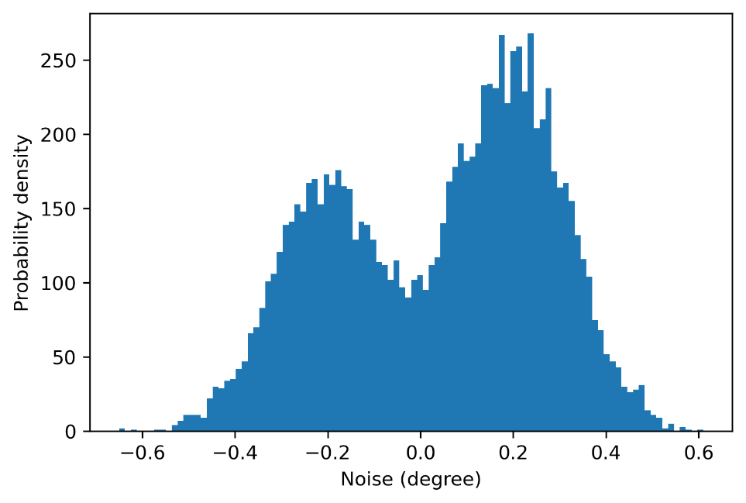
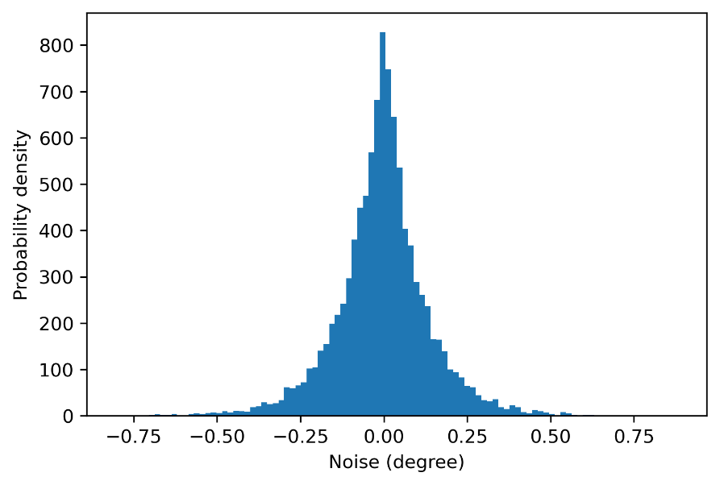
Options for Noise Characteristics

Slide 22
Main GUI
Users get two options:
Saved model testing
Train + Test from scratch

Slide 23
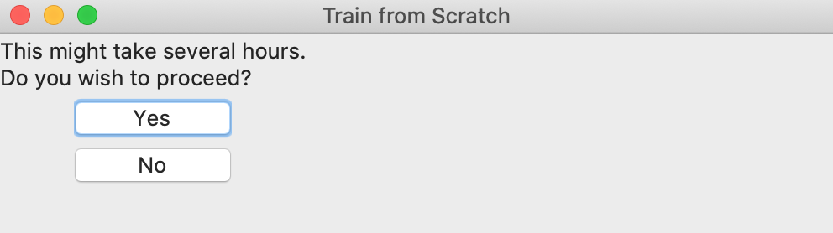
Train Prompt

Slide 24
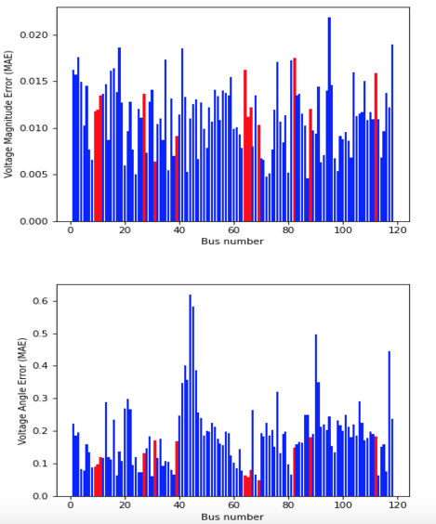
Result Prompt

Slide 25
Task 7 Updates

Slide 26
State Estimation with Utility Data
T₁
State Estimation Files (from utility)
Segregate files based on topology
T₂
T₃
For topology with highest number of samples (T₁)
Run power flow (PSSE/PSLF)
Voltage, Current
PMU locations
Voltage, Current PMU measurements
Train DNN-SE
PMU measurements (from utility)
Test DNN-SE
Results
Transfer learning can be used for obtaining the state estimation results for other topologies

Slide 27
Summary
A robust bad data replacement scheme (using the nearest operating condition) is explained
A method to detect line outages through DNN training is investigated
An initial version of the graphical user interface (GUI) is displayed
Basic functionalities such as uploading the data, choosing the noise characteristics, training the DNN, and displaying the basic results are demonstrated
Initial strategies for displaying the state estimator performance using real data from power utilities are developed

Slide 28
Next Steps
Task 5:
Line parameter estimation
Task 6:
Impact of bad data
Impact of missing data
Extreme scenario filter
Streamlining the GUI (improving visualization)
Task 7:
Data pre-processing
State estimation results

Slide 29
Q&A Thank You For Your Time

